Slide 1
Software Development Life Cycle (SDLC)

Slide 2
A framework that describes the activities performed at each stage of a software development project.
The software development life cycle (SDLC) is a process that consists of a series of well-defined phases through which software passes from its initial conception to eventual delivery to the customer. The SDLC provides a structure for understanding the phases of the software development process and a detailed description of each stage. It also helps ensure that all necessary steps are taken to complete the software development process.

Slide 3
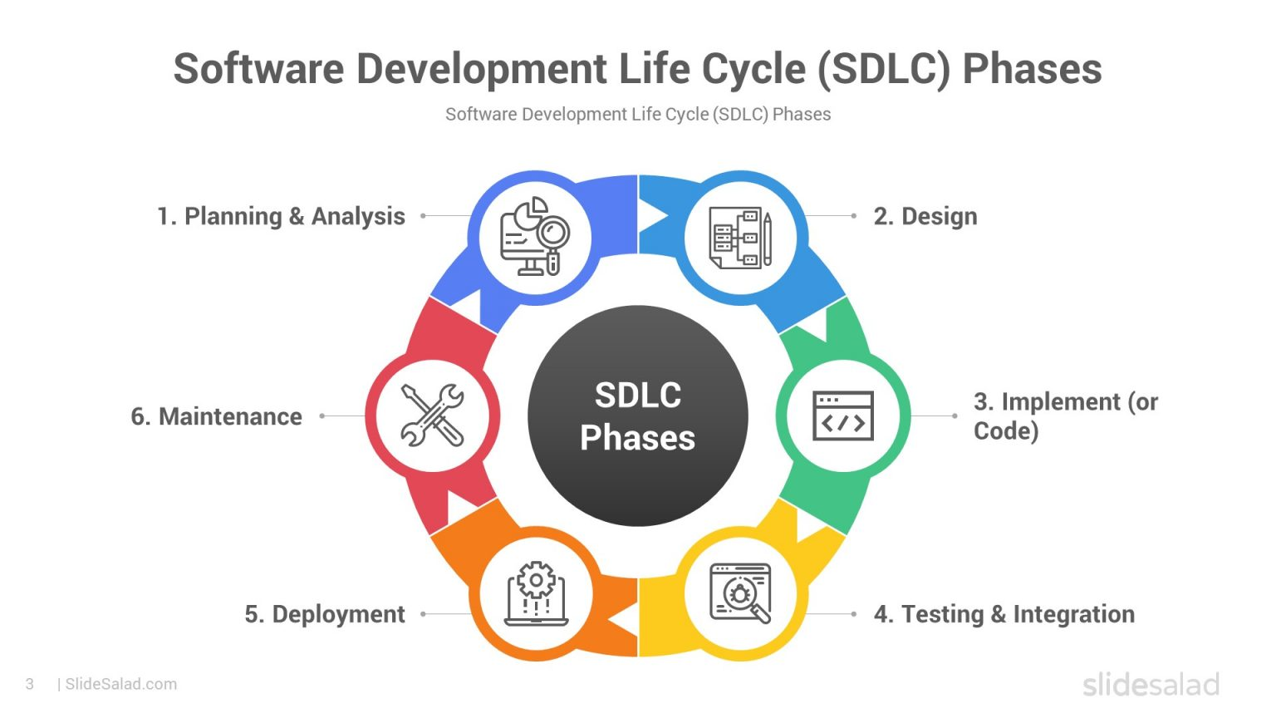
What is the Software Development Life Cycle (SDLC) (The Process)?

Slide 4
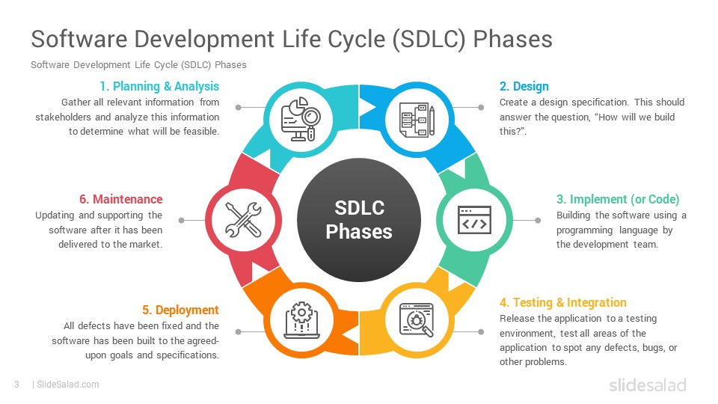

Slide 5
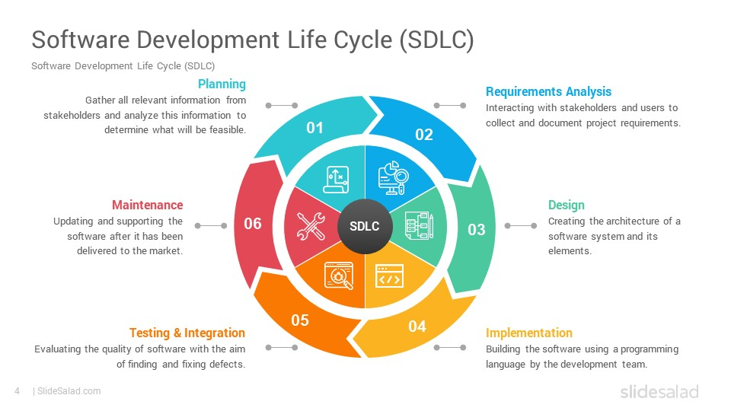

Slide 6
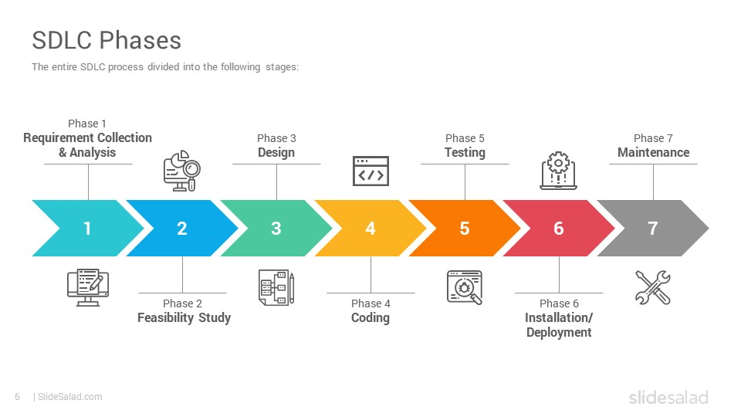

Slide 7
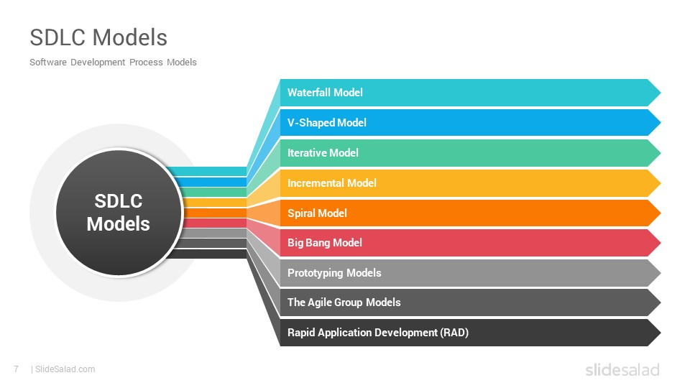

Slide 8
Waterfall Model

Slide 9
Waterfall approach was first SDLC Model to be used widely in Software Engineering to ensure success of the project. In "The Waterfall" approach, the whole process of software development is divided into separate phases. In this Waterfall model, typically, the outcome of one phase acts as the input for the next phase sequentially

Slide 10
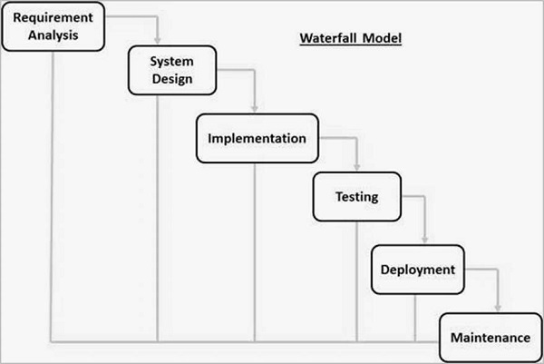

Slide 11
Requirement Gathering and analysis − All possible requirements of the system to be developed are captured in this phase and documented in a requirement specification document.
System Design − The requirement specifications from first phase are studied in this phase and the system design is prepared. This system design helps in specifying hardware and system requirements and helps in defining the overall system architecture.
Implementation − With inputs from the system design, the system is first developed in small programs called units, which are integrated in the next phase. Each unit is developed and tested for its functionality, which is referred to as Unit Testing.

Slide 12
Integration and Testing − All the units developed in the implementation phase are integrated into a system after testing of each unit. Post integration the entire system is tested for any faults and failures.
Deployment of system − Once the functional and non-functional testing is done; the product is deployed in the customer environment or released into the market.
Maintenance − There are some issues which come up in the client environment. To fix those issues, patches are released. Also to enhance the product some better versions are released. Maintenance is done to deliver these changes in the customer environment.

Slide 13
Waterfall Model - Advantages
Simple and easy to understand and use
Easy to manage due to the rigidity of the model. Each phase has specific deliverables and a review process.
Phases are processed and completed one at a time.
Works well for smaller projects where requirements are very well understood.
Clearly defined stages.
Well understood milestones.
Easy to arrange tasks.
Process and results are well documented.

Slide 14
Waterfall Model - Disadvantages
No working software is produced during the life cycle.
High amounts of risk and uncertainty.
Not a good model for complex and object-oriented projects.
Poor model for long and ongoing projects.
Not suitable for the projects where requirements are at a moderate to high risk of changing. So, risk and uncertainty is high with this process model.
It is difficult to measure progress within stages.
Cannot accommodate changing requirements.
Integration is done as a "big-bang. at the very end, which doesn't allow identifying any technological or business bottleneck or challenges early.

Slide 15
Iterative Model

Slide 16
Also called as incremental model
Project is break into small modules which can be delivered
A working version of the software is produced during the first module
Each subsequent release of the modules adds functionality to the previous release , the process continues till the complete system is achieved
This model is very successfully when working with new technology
More than one iteration can be going at the same time

Slide 17
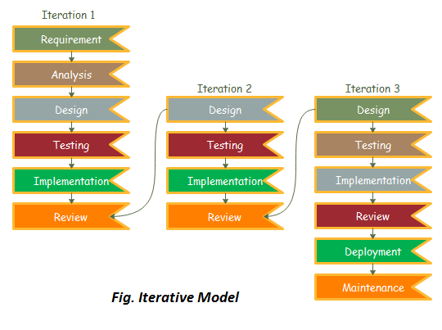

Slide 18
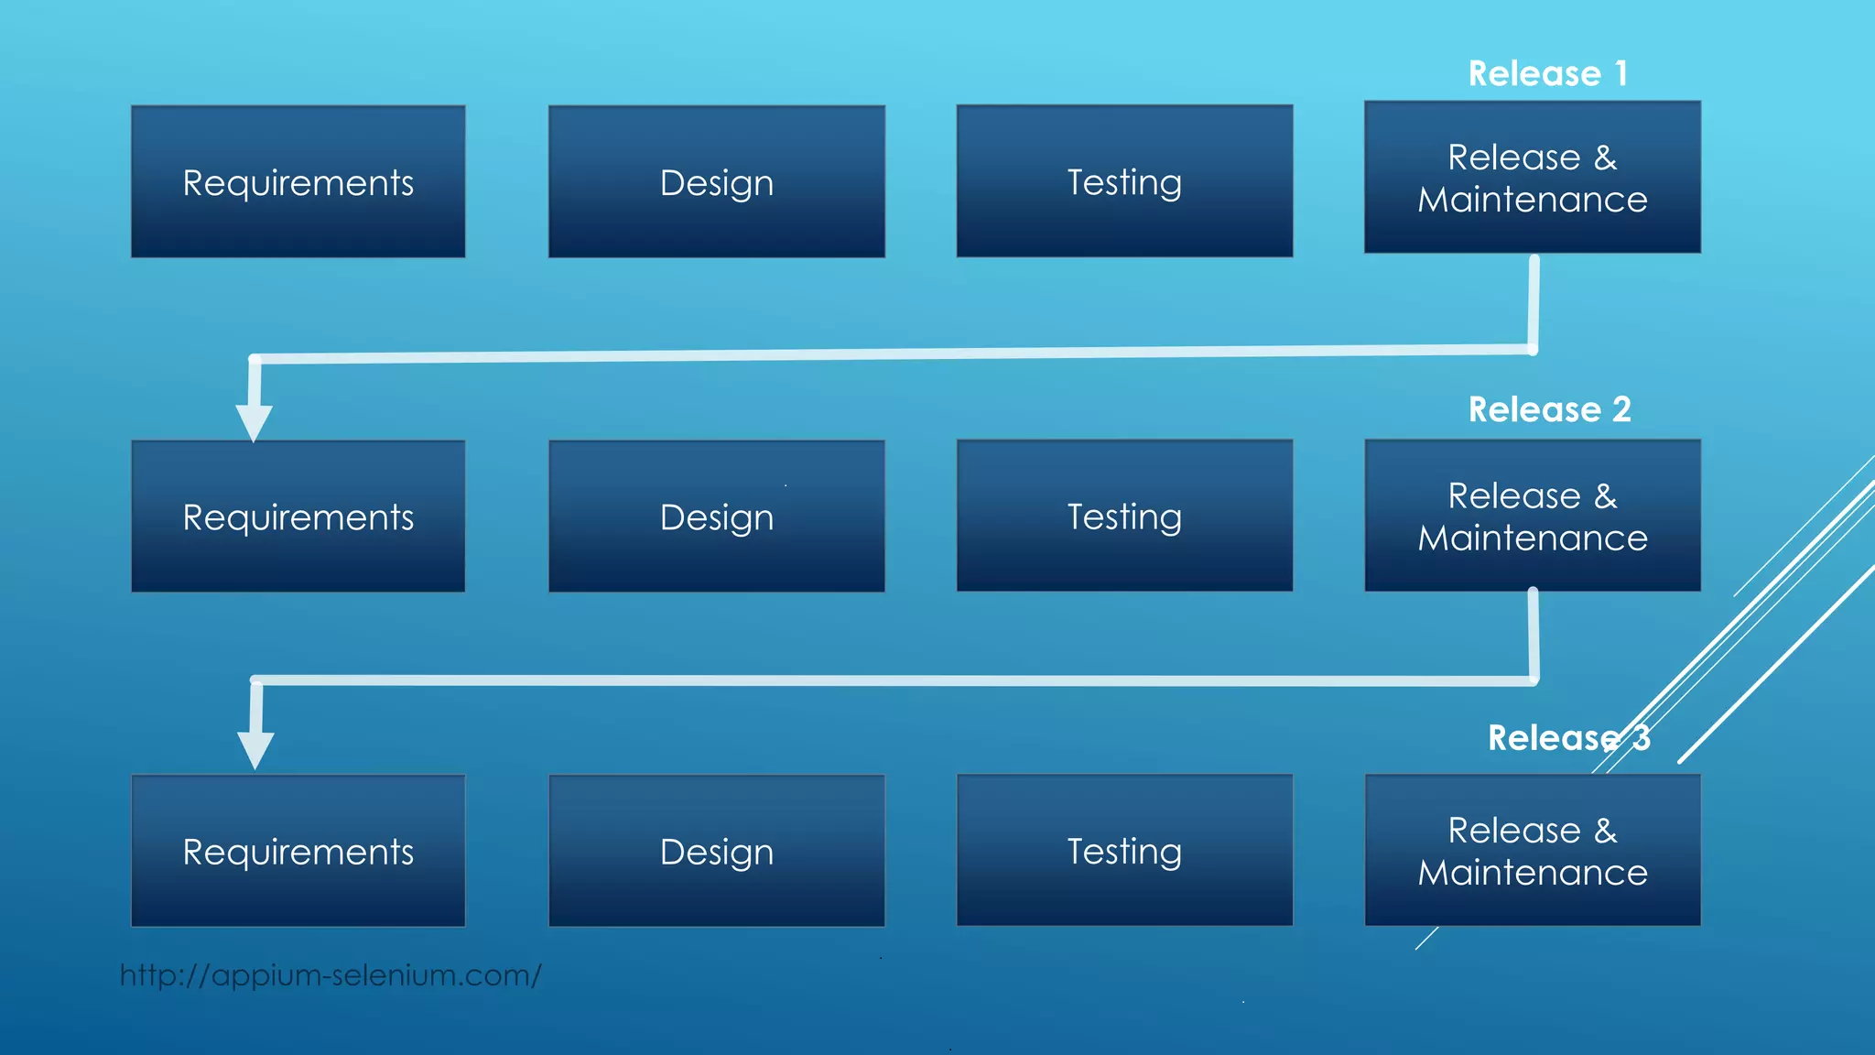

Slide 19
Advantages of iterative model
Quick software is released during the early phases of software life cycle
Less costly to change the requirements as compared to other models
Easier to develop and test when iterations are small
Customer can give feedback quickly
More than one iteration can be going parallel at the same time

Slide 20
Disadvantages of iterative model
Comparatively more resources are required
Skilled manager is needed to manage otherwise costing is increased
Project started with complete project architecture design can result failures in future
Cost is higher than waterfall model

Slide 21
Incremental Model

Slide 22
Incremental Model is a process of software development where requirements divided into multiple standalone modules of the software development cycle. In this model, each module goes through the requirements, design, implementation and testing phases. Every subsequent release of the module adds function to the previous release. The process continues until the complete system achieved.

Slide 23
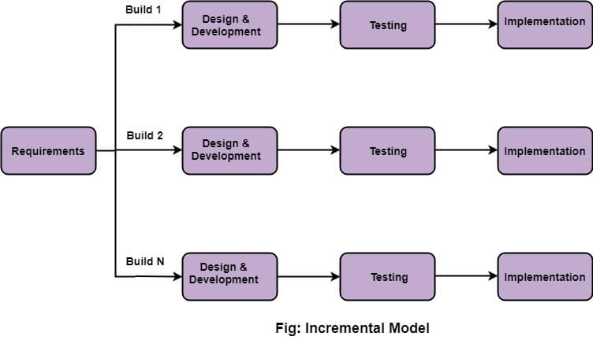

Slide 24
When we use the Incremental Model?
When the requirements are superior.
A project has a lengthy development schedule.
When Software team are not very well skilled or trained.
When the customer demands a quick release of the product.
You can develop prioritized requirements first.

Slide 25
Incremental Model
Advantages
Disadvantages
Errors are easy to be recognized
Easier to test and debug
More flexible.
Simple to manage risk because it handled during its iteration.
The Client gets important functionality early
Need for good planning
Total Cost is high.
Well defined module interfaces are needed

Slide 26
Spiral Model

Slide 27
It is best suited for complex embedded product development and situations where the requirements are changing from customers side
It support risk handling by evaluating the risks in each stage
It is the combination of waterfall and iterative model
The exact number of loops of the spiral is unknown and can vary from project to project
Each loop of the spiral is called a phase of the software development process

Slide 28
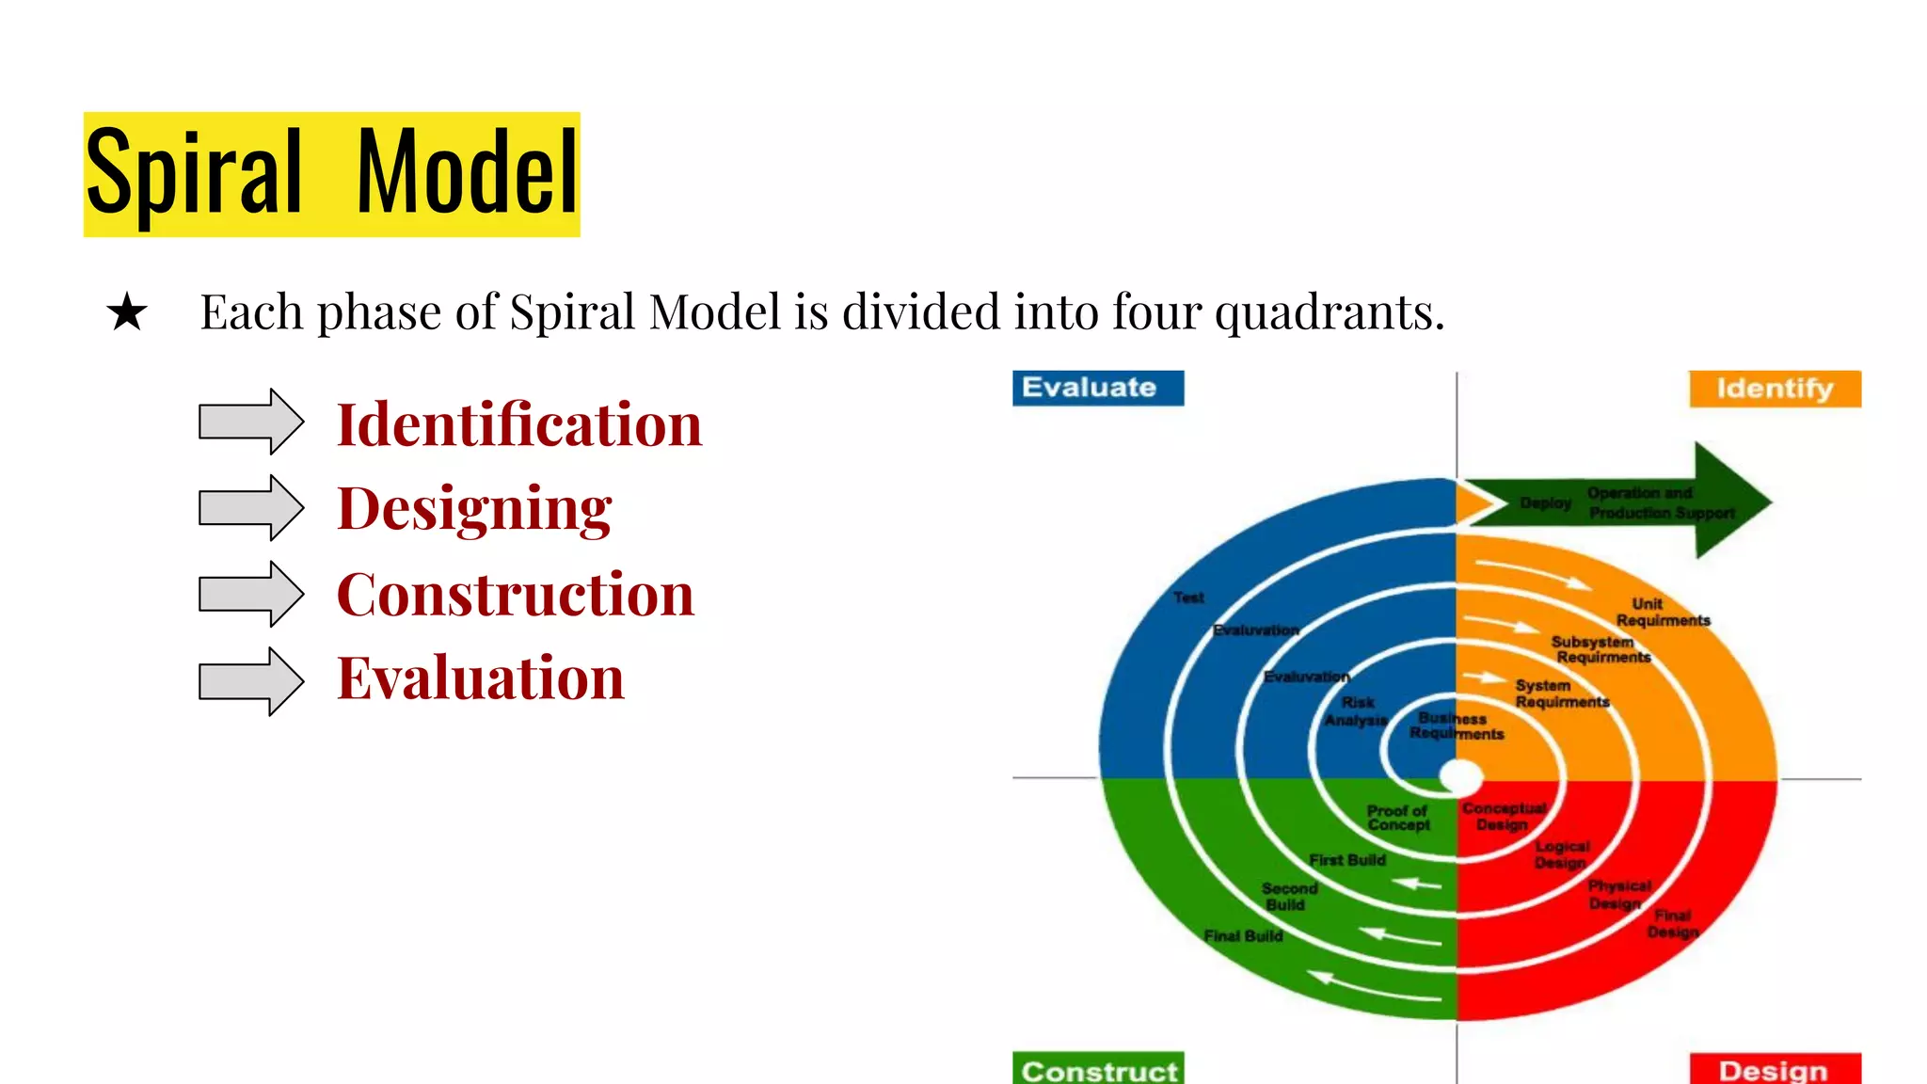

Slide 29
Identification
This phase starts with gathering the requirements
This phase also includes understanding the system requirements by continuous communication between the customer and the system analyst
The objectives are identified elaborated and analyzed at the start of every phase

Slide 30
Designing
This involves architectural design ,logical design of modules ,physical product design and the final design in the subsequent spirals
At the end of the quadrant prototype is build

Slide 31
Construction
This phase refers to production of the actual software product
The identical features are developed and verified through testing
At the end of the third quadrant , a new version of the software is available
These builds are sent to the customer feedback

Slide 32
Evaluation
In the fourth quadrant the customer evaluate the so far developed version of the software
The software development process enters the iteration and subsequently follows the linear approach to implement the feedback suggested by the customer
The process of iterations along the spiral continues throughout the life of the software

Slide 33
Spiral Model
Advantages
Disadvantages
Support risk handling
Best suited for larger projects
Flexibility in requirements
Customer satisfaction
More complex than any other SDLC models
Not suitable for small projects as it is expensive
Too much dependable on risk analysis
Difficulty in time management

Slide 34
V-Shaped SDLC Model

Slide 35
Introduction
It means verification and validation .
Just like Waterfall model, the life cycle of V Model is a sequential path of the execution of the process
Each phase must be completed before the next phase begins
The testing of the product is planned in parallel with corresponding phase of the development

Slide 36
Objectives when to use the V-model
It should be used for small to medium size projects where requirements are clearly defined
It should be chosen when simple technical resources are available with needed technical expertise

Slide 37
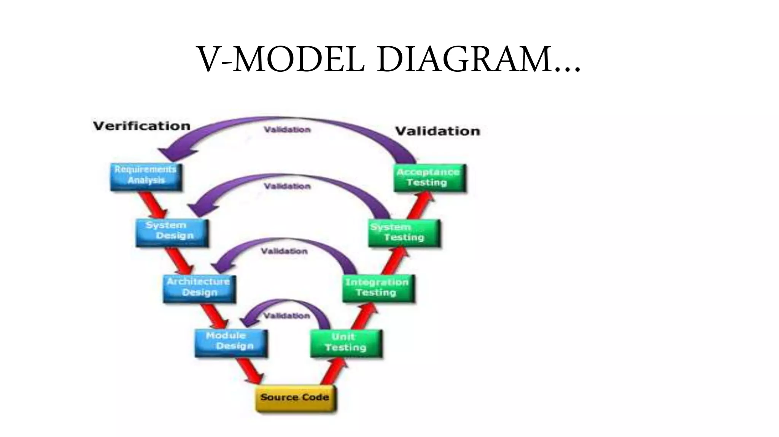

Slide 38
Different phases : Requirements
In this model the requirements are gathered before its development and a system test plan is created
The plan test focuses on meeting the functionality specified in the requirements gathering

Slide 39
The High level Design (HLD)
It focuses on system architecture and design
It provides overview of the solution ,platform system, product and services/process
An integrated test plan is created here as well as in order to test the pieces of the software system ability to work together

Slide 40
The Low Level Design (LLD)
Here the actual software components of software are design
Is defines the actual logic for each and every component of the system
Component test are created in this phase as well

Slide 41
Implementation
It is that phase where all the coding take place
Once the coding is complete the path of execution up the right side of the V where the test plans developed earlier are now put to use

Slide 42
Coding
This is at the bottom of the V-model
Module design is converted into code by developer

Slide 43
Advantages of V-Model
Simple and easy to use
Testing activities like planning ,test design happens well before coding
This saves a lot of time
Avoids the down flow of the defects
Works well for small projects where requirements are easily understood

Slide 44
Disadvantages of V-Model
High risk and uncertainty.
Not a good model for complex and object-oriented projects.
Poor model for long and ongoing projects.
Not suitable for the projects where requirements are at a moderate to high risk of changing.
Once an application is in the testing stage, it is difficult to go back and change a functionality.
No working software is produced until late during the life cycle.

Slide 45
Big Bang Model

Slide 46
The Big Bang model is an SDLC model where we do not follow any specific process. The development just starts with the required money and efforts as the input, and the output is the software developed which may or may not be as per customer requirement. This Big Bang Model does not follow a process/procedure and there is a very little planning required. Even the customer is not sure about what exactly he wants and the requirements are implemented on the fly without much analysis.
Usually this model is followed for small projects where the development teams are very small.

Slide 47
Big Bang Model ─ Design and Application
The Big Bang Model comprises of focusing all the possible resources in the software development and coding, with very little or no planning. The requirements are understood and implemented as they come. Any changes required may or may not need to revamp the complete software.
This model is ideal for small projects with one or two developers working together and is also useful for academic or practice projects. It is an ideal model for the product where requirements are not well understood and the final release date is not given.

Slide 48
The advantages of the Big Bang Model
This is a very simple model
Little or no planning required
Easy to manage
Very few resources required
Gives flexibility to developers
It is a good learning aid for new comers or students

Slide 49
The disadvantages of the Big Bang Model
Very High risk and uncertainty.
Not a good model for complex and object-oriented projects.
Poor model for long and ongoing projects.
Can turn out to be very expensive if requirements are misunderstood.

Slide 50
Agile Model

Slide 51
Agile SDLC model is a combination of iterative and incremental process models with focus on process adaptability and customer satisfaction by rapid delivery of working software product. Agile Methods break the product into small incremental builds. These builds are provided in iterations. Each iteration typically lasts from about one to three weeks.
Every iteration involves cross functional teams working simultaneously on various areas like −
Planning
Requirements Analysis
Design
Coding
Unit Testing and
Acceptance Testing.

Slide 52
What is Agile?
Agile model believes that every project needs to be handled differently and the existing methods need to be tailored to best suit the project requirements. In Agile, the tasks are divided to time boxes (small time frames) to deliver specific features for a release.
Iterative approach is taken and working software build is delivered after each iteration. Each build is incremental in terms of features; the final build holds all the features required by the customer.

Slide 53
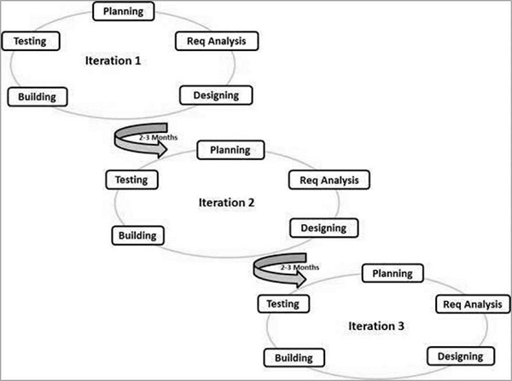

Slide 54
Following are the Agile Manifesto principles −
Individuals and interactions − In Agile development, self-organization and motivation are important, as are interactions like co-location and pair programming.
Working software − Demo working software is considered the best means of communication with the customers to understand their requirements, instead of just depending on documentation.
Customer collaboration − As the requirements cannot be gathered completely in the beginning of the project due to various factors, continuous customer interaction is very important to get proper product requirements.
Responding to change − Agile Development is focused on quick responses to change and continuous development.

Slide 55
The advantages of the Agile Model
Is a very realistic approach to software development.
Promotes teamwork and cross training.
Functionality can be developed rapidly and demonstrated.
Resource requirements are minimum.
Suitable for fixed or changing requirements
Delivers early partial working solutions.
Good model for environments that change steadily.
Minimal rules, documentation easily employed.
Enables concurrent development and delivery within an overall planned context.
Little or no planning required.
Easy to manage.
Gives flexibility to developers.

Slide 56
The disadvantages of the Agile Model
Not suitable for handling complex dependencies.
More risk of sustainability, maintainability and extensibility.
An overall plan, an agile leader and agile PM practice is a must without which it will not work.
Strict delivery management dictates the scope, functionality to be delivered, and adjustments to meet the deadlines.
Depends heavily on customer interaction, so if customer is not clear, team can be driven in the wrong direction.
There is a very high individual dependency, since there is minimum documentation generated.
Transfer of technology to new team members may be quite challenging due to lack of documentation.

Slide 57
Rapid Application Model (RAD)

Slide 58
RAD is a linear sequential software development process model that emphasizes a concise development cycle using an element based construction approach. If the requirements are well understood and described, and the project scope is a constraint, the RAD process enables a development team to create a fully functional system within a concise time period.

Slide 59
RAD (Rapid Application Development) is a concept that products can be developed faster and of higher quality through:
Gathering requirements using workshops or focus groups
Prototyping and early, reiterative user testing of designs
The re-use of software components
A rigidly paced schedule that refers design improvements to the next product version
Less formality in reviews and other team communication

Slide 60
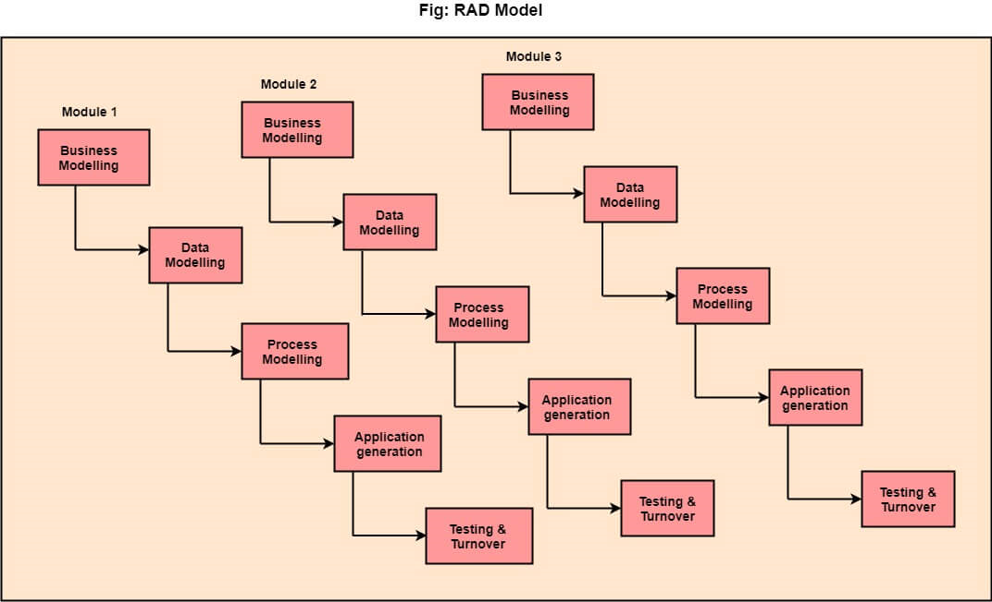

Slide 61
The various phases of RAD are as follows:
Business Modelling: The information flow among business functions is defined by answering questions like what data drives the business process, what data is generated, who generates it, where does the information go, who process it and so on.
Data Modelling: The data collected from business modeling is refined into a set of data objects (entities) that are needed to support the business. The attributes (character of each entity) are identified, and the relation between these data objects (entities) is defined.

Slide 62
Process Modeling: The information object defined in the data modeling phase are transformed to achieve the data flow necessary to implement a business function. Processing descriptions are created for adding, modifying, deleting, or retrieving a data object.
Application Generation: Automated tools are used to facilitate construction of the software; even they use the 4th GL techniques.
Testing & Turnover: Many of the programming components have already been tested since RAD emphasis reuse. This reduces the overall testing time. But the new part must be tested, and all interfaces must be fully exercised.

Slide 63
When to use RAD Model?
When the system should need to create the project that modularizes in a short span time (2-3 months).
When the requirements are well-known.
When the technical risk is limited.
When there's a necessity to make a system, which modularized in 2-3 months of period.
It should be used only if the budget allows the use of automatic code generating tools.

Slide 64
RAD
Advantages
Disadvantages
This model is flexible for change.
In this model, changes are adoptable.
Each phase in RAD brings highest priority functionality to the customer.
It reduced development time.
It increases the reusability of features.
It required highly skilled designers.
All application is not compatible with RAD.
For smaller projects, we cannot use the RAD model.
On the high technical risk, it's not suitable.
Required user involvement.

Slide 65
Prototype Model

Slide 66
Prototype Model
The prototype model requires that before carrying out the development of actual software, a working prototype of the system should be built.
A prototype usually turns out to be a very crude version of the actual system, possible exhibiting limited functional capabilities, low reliability, and inefficient performance as compared to actual software.

Slide 67
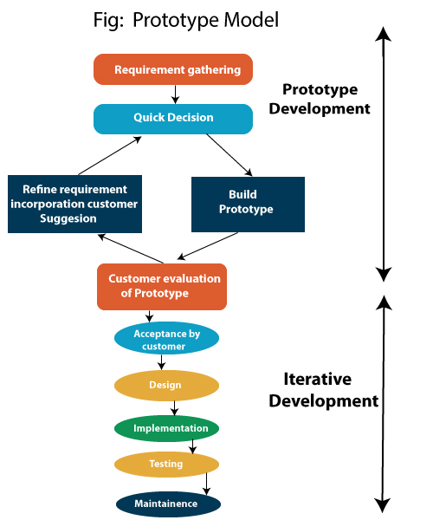

Slide 68
Prototype Model
Advantages
Disadvantages
Reduce the risk of incorrect user requirement
Regular visible process aids management
Support early product marketing
Reduce Maintenance cost.
Errors can be detected much earlier as the system is made side by side.
An unstable implemented prototype often becomes the final product.
Require extensive customer collaboration
Costs customer money
Difficult to finish if customer withdraw
Difficult to know how long the project will last.
Prototyping tools are expensive.
Special tools & techniques are required to build a prototype.
It is a time-consuming process.

